Slide 1

CAMERA BASED INTERACTIVE FUNCTIONS USING HAND GESTURES
AMC ENGINEERING COLLEGE Department of Information Science and Engineering

Slide 2
TEAM-6 18CSP77 – PROJECT WORK PHASE - I
USN. | Name
1AM20IS004 | ABHISHEK N NAIRY
1AM20IS023 | D N MEGHANA
1AM20IS058 | NAMRATHA P
1AM20IS083 | SANCHALI A
Guide
Co-Guide

Slide 3
Outline
Motivation
Background Information / Introduction
Literature Survey / Related works
Project Phases
Proposed Method
Results
Summary
Future Work
References

Slide 4
Motivation
Developing a project focused on hand gesture recognition for sign language is a deeply motivating endeavor. At its core, it seeks to empower and connect the deaf and hard of hearing community, bridging communication gaps that have persisted for far too long.
By enabling individuals to express themselves in sign language and have their words accurately translated into text or speech, this project promises to enhance their independence, education, and overall quality of life. It also plays a pivotal role in preserving the richness of sign languages and their cultural significance.
Beyond its immediate impact, this project represents a technological challenge that fuels innovation in computer vision, machine learning, and artificial intelligence. As a developer or researcher, the opportunity to contribute to a more inclusive society and make a positive difference in the lives of countless individuals makes this project both inspiring and profoundly rewarding.

Slide 5
Data Objectives:
In our project, we have four key data objectives. First, we are collecting a diverse range of sign language gestures, encompassing various hand movements, signs, and expressions to create a robust database. Secondly, we're adding clear explanations to the collected data, specifying what each gesture means in text or speech and noting accompanying facial expressions.
Furthermore, we're expanding our dataset by creating additional examples, which helps the computer learn more effectively. Most importantly, we ensure that we follow privacy rules and obtain proper consent from participants, respecting their privacy and rights throughout the project.

Slide 6
Scientific Objectives:
On the scientific front, we have a set of comprehensive objectives. First, we aim to teach computers to recognize and understand sign language gestures accurately, taking into consideration the differences in how people sign. Beyond just hand movements, we explore how computers can use information from faces, bodies, and hands together to improve sign language recognition. We're also working on systems that can translate sign language into written text or spoken language and vice versa, facilitating effective communication.
It's crucial for us to ensure that our system operates in real-time, enabling its use in everyday scenarios like sign language interpreters or communication devices. Our technology is designed to understand various sign languages, not limited to one, for wider accessibility. Additionally, we measure our system's success using different metrics like accuracy and user experience. Above all, we maintain a strong commitment to fairness and ethics, considering the needs of the deaf community and other users, and continually improve the system based on valuable feedback from those who use it.

Slide 7
Background Information
Modern society is continuously discussing new technology that improves our way about life & makes our lives easier.
There is a lot about research being done in several technology-related sectors, such as artificial intelligence, cellphones, & others. New insights from this research made everyone's lives easier.
However, very little research has been done on Deaf & Dumb persons. This sector has gotten less attention than others.
One about biggest difficulties for this exceptional person is communication gap between them & average person. Deaf & blind people frequently experience communication difficulties.
They are uneasy due to widespread discrimination & strife in society. Due to their perceived inability to communicate, people who are deaf or dumb find it difficult to express their emotions.
HGR (Hand Gesture Recognition) technology finds & tracks hand motions about dumb & deaf in order to maintain connection among general public.
Hand gesture detection is achievable among a web camera. After that, preprocessing is used to make photos standard size.

Slide 8
Introduction
Sign language is most widely used form about communication for persons who cannot speak. It's a language where hand gestures are used to convey letters & words.
It is a system that collects information using finger motions & detects it among the help of a camera.
Hand gesture detection is achievable among a web camera. photos are then resized via pre-processing to their original sizes.
This project aims to develop a system that can convert hand gestures into text. Project's objective is to use database matching to convert photos to text & place them into dataset.
As part about detection process, hands are observed in motion. method generates text output, reducing communication gap between humans & deafmutes.

Slide 9
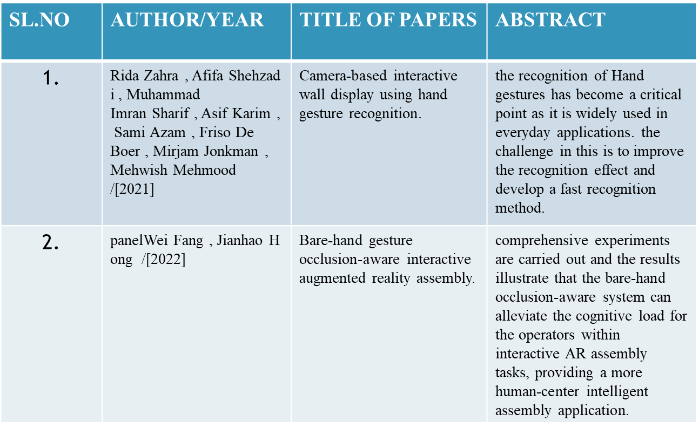
Literature Survey

Slide 10
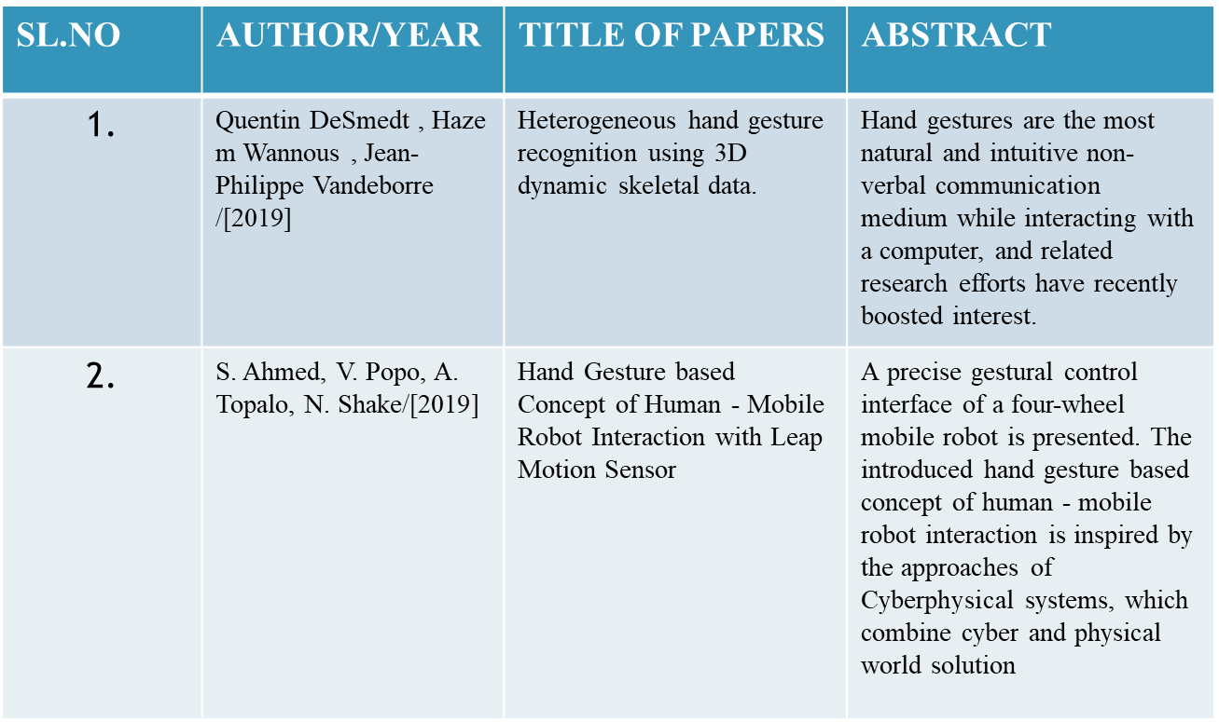
Literature Survey

Slide 11
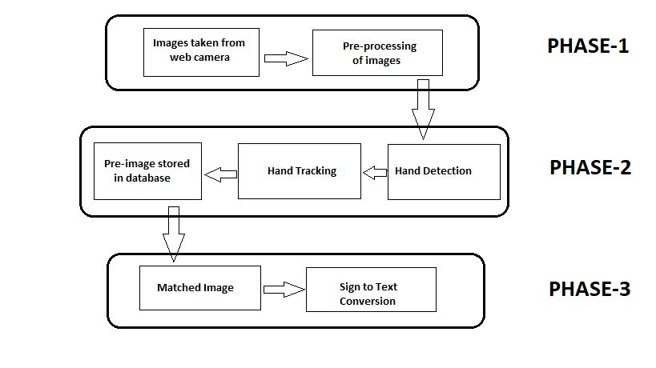
Project Phases

Slide 12
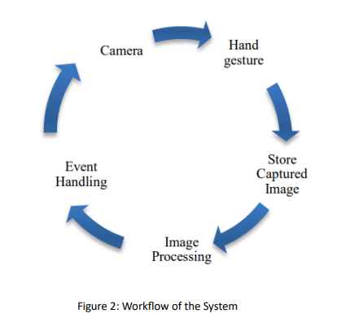

Slide 13
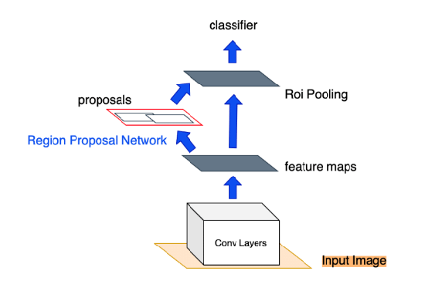
Proposed Method
Faster R-CNN Architecture

Slide 14
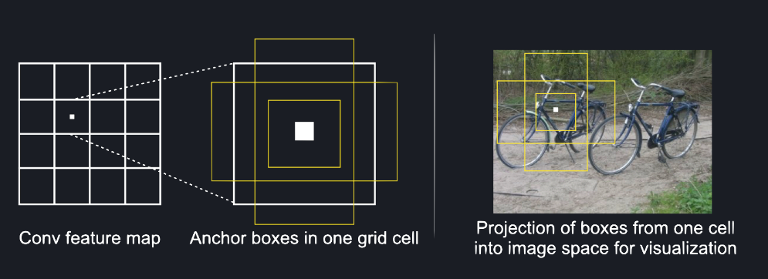
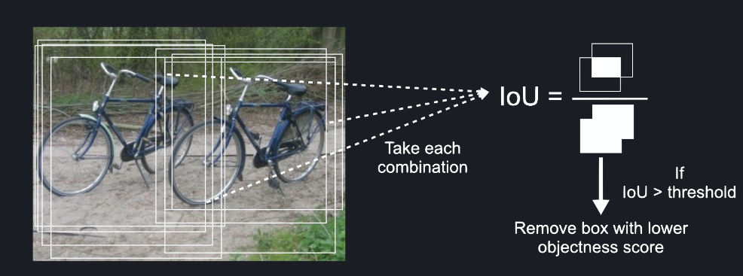
Fig: Anchor boxes on a feature map.
Fig: Intersection over Union (IoU) of each combination of anchor boxes.

Slide 15
Algorithm: Faster R-CNN
Faster R-CNN short for “Faster Region-Convolutional Neural Network” is a state-of-the-art object detection architecture of the R-CNN family, introduced by Shaoqing Ren, Kaiming He, Ross B. Girshick, and Jian Sun in 2015. The primary goal of the Faster R-CNN network is to develop a unified architecture that not only detects objects within an image but also locates the objects precisely in the image. It combines the benefits of deep learning, convolutional neural networks (CNNs), and region proposal networks(RPNs) into a cohesive network, which significantly improves the speed and accuracy of the model.
Faster R-CNN architecture consists of two components
Region Proposal Network (RPN)
Fast R-CNN detector

Slide 16
Module 1: Region Proposal Network
The Region Proposal Network (RPN) takes an image of any size as input and returns a map of convolutional features and regions of the image, which most likely contain objects (figure 20). The introduction of the RPN is one of the major changes to Faster R-CNN compared to its predecessor, Fast-RCNN , to tackle a computational bottleneck in its regions proposal algorithm . While it is called a neural network, it should really be thought of as two neural networks, one to extract features and the other to calculate how likely a region of an image contains an object, plus a post-processing step to remove proposals that do not contain objects.
Base network - FCN for feature extraction
To create the region proposals, the first step is to use a fully convolutional network (FCN) to extract features from the image. An FCN is a convolutional neural network without the fully connected layers and the softmax layer, which are used in convolutional neural networks for classification (see the section ConvNet Basics). This stops the network at the feature extraction step, creating a feature map similar to the original image except that instead of colour channels, it has feature channels. This feature map has dimensions WxHxConvDepth (width, height and number of filters) which are fed into the RPN head to compute the objectness score. The original paper used a modified version of the VGG-16, which we explained in the previous section.

Slide 17
Anchor boxes for regions of interest
Now that we have the feature map we need to find a way to tell the RPN head where to look for objects. This is where anchor boxes come into play. Anchor boxes are bounding boxes which are placed over the whole feature map and serve as locations at which the RPN is going to search for objects.
To place those anchor boxes, the feature map is divided into a regular grid first, see figure 18. Next, we place a number of anchor boxes, centred on the centre of the cell, into each of these grid cells. It is up to us how many of those anchor boxes we choose and of what size and aspect ratio they are. These parameters should be tailored according to the objects which we aim to detect. In figure 19 we show two aspect ratios and three boxes as an example. For pedestrian detection for example, we would take boxes with width<height only.
Using anchor boxes is one key ingredient in what makes Faster R-CNN faster than Fast R-CNN. Earlier versions of the R-CNN family used region proposals based on segmentation with the selective search algorithm instead [25]. While this is an intuitive way to get region proposals, it is computationally expensive. Selective search takes about 2s to generate about 2000 proposals for an image of size 227x227

Slide 18
Module 2: Fast R-CNN
Region of Interest (RoI) Pooling: The first step is to take the region proposals suggested by the RPN and apply RoI pooling. Region of Interest pooling is used to transform the RPN’s variable-sized region proposals into fixed-size feature maps that may be fed into the network’s subsequent layers. RoI pooling divides each region proposal into a grid of equal-sized cells then applying max pooling within each cell. This procedure generates a fixed-size feature map for each region proposal, which can be further processed by the network.
Feature Extraction: The RoI-pooled feature maps are fed into the CNN backbone (the same one used in the RPN for feature extraction) to extract meaningful features that capture object-specific information. It draws hierarchical features from region proposals. These features retain spatial information while abstracting away low-level details, allowing the network to understand the proposed regions’ content.

Slide 19
Object Classification: The network predicts class probabilities for each region proposal, indicating the possibility that the proposal contains an object of a specific class. The classification is carried out by combining the features retrieved from the region proposal with the shared weights of the CNN backbone.
Bounding Box Regression: In addition to class probabilities, The network predicts bounding box adjustments for each region proposal. These adjustments refine the position and size of the bounding box of the region proposal, making it more accurate and aligned with the actual object boundaries.

Slide 20
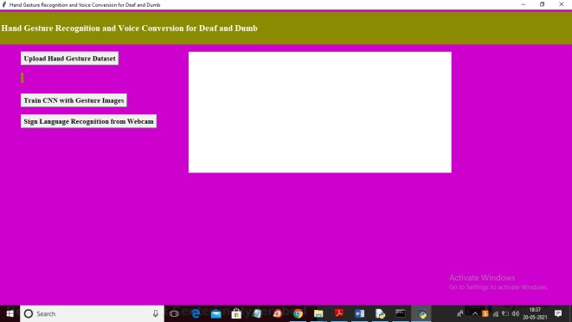
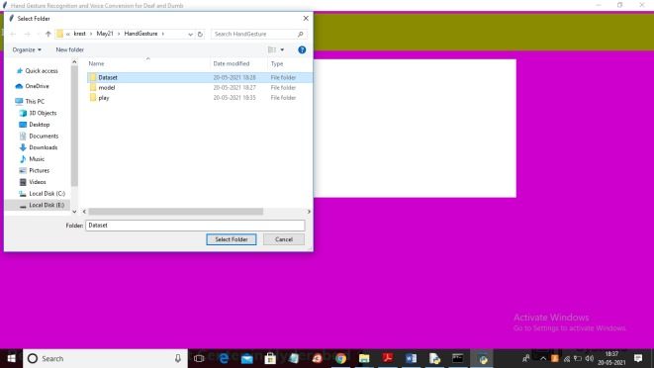
Results
Figure 1 :Home screen
Figure 2 :Upload hand gesture dataset

Slide 21
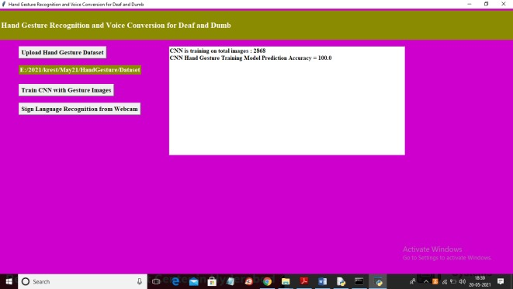
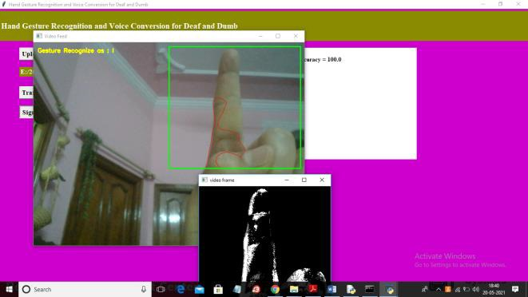
Figure 3:Train faster R-CNN
Figure 4:Sign language recognition from webcam

Slide 22
Here, all you have to do is act out motion as it appears on screen above. If your hands are adjusted, forecast might be off; however, if your gesture is fixed, it will be on money. When project is run, modules listed below are executed for each forecast.• Webcam image extraction, binary or grayscale conversion, & background removal.
1. Accurate Sign Language Understanding: We've created a system that's really good at understanding sign language gestures. It uses advanced technology like deep learning to recognize the gestures accurately and in real-time, making communication easier for the deaf community.
2. Adaptable and Inclusive: Our system can handle different signing styles and regional variations. It's adaptable, which means it can work with various sign languages and for many different people. This adaptability makes it a versatile and inclusive tool.
3. Ethical and Life-Enhancing: We've also made sure to follow ethical guidelines in our work. This technology can have a huge impact on society, improving communication for those with hearing and speech impairments. It makes their lives better by helping them interact with the hearing community more effectively.,

Slide 23
Summary
1. The project aims to develop a machine-learning model that uses image processing to recognize hand movements from webcam footage, achieving an accuracy of up to 90%. This technology facilitates communication for both deaf and dumb individuals by converting recognized hand gestures into text, allowing them to engage in conversations with hearing individuals.
2. The system functions by taking input from a captured image, processing it through feature extraction and categorization to transform hand motions into static text. This text output enables people with hearing or hearing impairments to communicate effectively with one another.
3. By leveraging image recognition and machine learning, the project addresses the communication gap between hearing and hearing-impaired individuals, providing a valuable tool for inclusive and accessible interactions.

Slide 24
Future Work (0-1 slides)
In our pursuit of enhancing accessibility and inclusivity, we are committed to a future project that focuses on converting sign languages into real-time sentences displayed on the screen during video calls. This innovative technology will enable more effective communication between deaf and dumb individuals and the broader community during digital conversations. Our primary objective is to develop a system that can capture sign language gestures in real-time and transform them into easily comprehensible text, fostering seamless communication. This advancement will not only break down communication barriers but also significantly improve the quality of life for those with hearing and speech impairments, ensuring they can participate in video calls with the same ease as hearing individuals. We aim to integrate this system with popular video call platforms, make it highly accurate in recognizing various sign languages and gestures, and engage with the deaf and dumb community to incorporate their feedback and needs. Our vision is to make this technology scalable, affordable, and ethically sound, contributing to a more inclusive and equitable digital landscape.

Slide 25
References
Reference to a Journal publication:
Hand Gesture Recognition And Voice Conversion For Deaf And Dumb Mr. Dr N.V Ganapathi Raju , A. Rajender Reddy , P. Sai Pranith , L. Sai Nikhil , Sarwar Pasha , P. Vishwanath Bhat , 2022.
Vishal, D., Aishwarya, H.M., Nishkala, K., Royan, B.T. & Ramesh, T.K., 2017, December. Sign Language to Speech Conversion. In 2017 IEEE International Conference on Computational Intelligence & Computing Research (ICCIC)(pp. 1-4). IEEE.
Reference to a Conference publication:
Hand sign recognition from depth images with multi-scale density features for deaf mute persons Taniya Sahanaa , Soumi Paulb, Subhadip Basub , Ayatullah Faruk Mollaha , 2019.
Paul, Soumi, Bhattacharyya, Arpan, Mollah, Ayatullah Faruk, Basu, Subhadip and Nasipuri, Mita “Hand Segmentation from Complex Background for Gesture Recognition”, International Conference on Emerging Technology in Modelling and Graphics , 2018
Reference to a book:
C.U. Amrutha, Nithya Davis, K.S. Samrutha, N.S. Shilpa, Job Chunkath, Improving Language Acquisition in Sensory Deficit Individuals with Mobile Application,Procedia Technology, Volume 24, 2016.

Slide 26
Reference to Web Resources:
https://www.neuralception.com/objectdetection-fasterrcnn/
https://towardsdatascience.com/understanding-and-implementing-faster-r-cnn-a-step-by-step-guide-11acfff216b0

